Slide 1
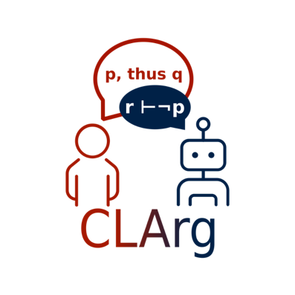
Interactive Explanations of Large Language Models using Argumentative Agents Adam Dejl, Deniz Gorur Imperial College London explAIn 2023

Slide 2
Motivation
LLMs showed a great capability.
However,
LLMs are prone to hallucinations, and
LLMs are hard to explain, and
LLMs may not perform to the best of their ability if prompted imperfectly.
Was the Huxley building at Imperial College named after Aldous Huxley?
Yes, the Huxley building at Imperial College was named after Aldous Huxley.
Who was the Huxley building at Imperial College named after?
The Huxley building at Imperial College was named after the British biologist Thomas Henry Huxley.

Slide 3
Background - Argumentation
Computational argumentation is a reasoning paradigm.
A Quantitative Bipolar Argumentation Framework (QBAF) ^{[Baroni et al. 2019]} is a tuple ⟨𝒳, 𝒜, 𝒮, 𝜏⟩:
𝒳 is a set of arguments;
𝒜 is a binary relation of attack on 𝒳 , 𝒜 ⊆ 𝒳 × 𝒳;
𝒮 is a binary relation of support on 𝒳 , 𝒮 ⊆ 𝒳 × 𝒳 ; and
𝜏 : 𝒳 → [0, 1] is a total function; 𝜏(𝑎) is the base score of 𝑎 ∈ 𝒳.
Strength of arguments can be derived using gradual semantics ^{[Baroni et al. 2019]}.
𝜏(a)=0.5
𝜎(a)=0.7
a: Covid vaccines are safe
-
𝜏(b)=0.4
𝜎(b)=0.4
+
𝜏(c)=0.8
𝜎(c)=0.8
b: Like all medical interventions, vaccines may have rare side effects or adverse reactions, which can pose risks to some individuals
c: COVID vaccines' safety is supported by rigorous testing and real-world evidence, demonstrating their low risk compared to the severe risks posed

Slide 4
Solution - Argumentative Agents
Prompt for
arguments
Ask question
Return result and explanation
Return arguments
User
Argumentative
Agent
LLM
Interact
Apply gradual
semantics
Construct
Request
evaluation
0.5
Subset
-
Return base scores (𝜏)
0.4
0.8
+
0.5
Update
0.8
+
Argument
Evaluator
Explanation
QBAF

Slide 5
Applications
Forecasting
f₁: LLMs will reach AGI before 2030
-
+
d₁: Mere increase of scale of machine learning models may not be sufficient to reach AGI
d₂: As the number of parameters in LLMs have increased, emergent abilities have been observed
Robotics
a₁: Next step for doing the laundry should be turning the washing machine on
-
+
d₁: There is no washing powder in the machine
d₂: The laundry is loaded in the washing machine
-
d₃: Some dirty clothes are in the basket

Slide 6
Thanks For Listening! QUESTIONS?

